Slide 1
DROWSINESS
DETECTION SYSTEM

Slide 2
DROWSINESS DETECTION SYSTEM
Team Members :
BAGAWATH RP
REVATHI S
SARADHA R
SHILPA GLORY D
Guided By,
Dr. G. Nalinipriya M.E., Ph.D.,
Professor,
Dept. of Information Technology,
Saveetha Engineering College.

Slide 3
AGENDA
Problem Statement
Abstract
Domain
Existing System
Proposed System
Literature Survey
Architecture Diagram
Project Modules
Algorithm
Pseudocode
UML Diagram
Hardware / Software Requirement
Conclusion
Snap Shots
References

Slide 4
PROBLEM STATEMENT
Over 13% of crashes and accidents happen due to falling asleep.
Drivers lose concentration and rotate the steering harshly.
Accidents are occurring due to sleep or drowsiness.

Slide 5
ABSTRACT
In this busy world , transportation is necessary to travel from one place to another. Most people are comfortable in traveling in their own vehicle than in public transport. Though there are many advantages in having a own vehicle , there are disadvantages too. In a busy and tiring day , there are possibilities where the driver can sleep during travel which is high risk for himself and others. In many cases , it has lead to major accidents and lose of life. The same risks apply to public transport driver.

Slide 6
ABSTRACT
“Drowsiness detection system” is a car safety technology which prevents the accidents during driving. A camera is used to monitor the driver’s eye movement. If the predefined safety conditions are not met , it alerts the driver by producing some vibrations in the seat belt. Taking an account of worst case scenario , if any accident occurs , the location of the vehicle is notified to the nearby hospitals.

Slide 7
DOMAIN : ARTIFICIAL INTELLIGENCE IN SAFE DRIVING
Artificial intelligence (AI) is intelligence demonstrated by machines, unlike the natural intelligence displayed by humans and animals, which involves consciousness and emotionality.
Artificial intelligence is based on the principle that human intelligence can be defined in a way that a machine can easily mimic it and execute tasks from the most simple to those that are even more complex.
The goals of artificial intelligence include mimicking human cognitive activity such as learning, reasoning, and perception.

Slide 8
EXISTING SYSTEM
By using a non-intrusive machine vision-based concepts, drowsiness of the driver detected system is developed. Many existing systems require a camera which is installed in front of driver. It points straight towards the face of the driver and monitors the driver’s eyes in order to identify the drowsiness. For large vehicle such as heavy trucks and buses this arrangement is not pertinent. Bus has a large front glass window to have a broad view for safe driving.
If we place a camera on the window of front glass, the camera blocks the frontal view of driver so it is not practical. If the camera is placed on the frame which is just about the window, then the camera is unable to detain the anterior view of the face of the driver correctly.
The open CV detector detects only 40% of face of driver in normal driving position in video recording of 10 minutes. In the oblique view, the Open CV eye detector (CV-ED) frequently fails to trace the pair of eyes. If the eyes are closed for five successive frames the system concludes that the driver is declining slumbering and issues a warning signal. Hence existing system is not applicable for large vehicles. In order to conquer the problem of existing system, new detection system is developed in this project work.

Slide 9
PROPOSED SYSTEM
Here we use AI to detect the facial expression of the driver.
If the driver’s eyes are closed for more than few seconds , it creates vibration in the seat belt to bring the driver into consciousness.
It creates a stiffness to the steering to make sure the car direction is controlled.
In case of heart attack or other health emergencies , it sends message to nearby hospitals and close members.

Slide 10
LITERATURE SURVEY
Gerald Kaefer, Guenter prochart and Reinhold Weiss [1] proposed a wearable alertness monitoring the guard using the physical measures like detecting eye lid closure, reaction time, head movements. A high level of alertness is one of the most important requirements for people working in dangerous environments was then studies.
Prachi Parikh and Evangelia Micheli-Tzankao[2] introduced an ECG signal as an alertness of an individual. The movement of an individual was recorded and their movement was analyzed. It had a color code which makes it easier to observe the ways, which enables to give instant feedback.
IN [3] knowing that ECG and EOG signals are complex in nature , the process has to be investigated precisely in nature. Thus, EOG signals were recorded between Cornea and Retina. Discrete wavelet was used to decompose the EOG signals

Slide 11
LITERATURE SURVEY
Smita Jawale, Pragati Malvadia, Ashwini Meena [4] has introduced a image monitoring technique ie, a camera is fixed so that it keeps monitoring the person’s movement. It senses if the person lose his consciousness and immediately sends an alert alarm. They also proposed a computing horizontal technique so as to know the intensity change of the eye location.
Raees Ahmad[5]improved the system by implementing it by using the cascade object identifier from vision toolbox of matlab, that detects face , eyes ,nose and mouth from the image which Is captured using the web camera and the system provides efficient analysis and good efficiency because,it formulates the different categories of drivers like the drivers with glasses under different light intensities and normal drivers too.
Takchito Hayami[6] introduced a system called PERCLOS which determines frequency between the wakeful and drowsy state of the driver. It is determines the threshold level between the possibilities and the distinction error was evaluated and the drowsy state was analyzed.

Slide 12
LITERATURE SURVEY
Robert Gabriel Lupu [7] has stated that depending upon the source light point of view , there are two approaches namely based on ambient and infrared lights. This has an advantage of low computing resources , this comes under the feature based algorithm. On the other hand , the model based algorithm do not detect features but rather finds the best model that is consistent with the image.
Algorithm for Eye Detection on Grey Intensity Face[8] this paper presents a robust eye detection algorithm for grey intensity images.
Face Detection using Haar Casades [9] Object Detection using Haar feature-based cascade classifiers is an effective object detection method proposed by Paul Viola and Michael Jones in their paper “Rapid Object Detection using a Boosted Cascade of Simple Features” in 2001.
Apurva Patil , Archies Patil, Siddhi Shenoy [10] proposed a computer vision technology which involves in determining the observation of eye movements , mouth movement and blink pattern. This includes the yawning which helps in determining the accurate mouth movement.

Slide 13
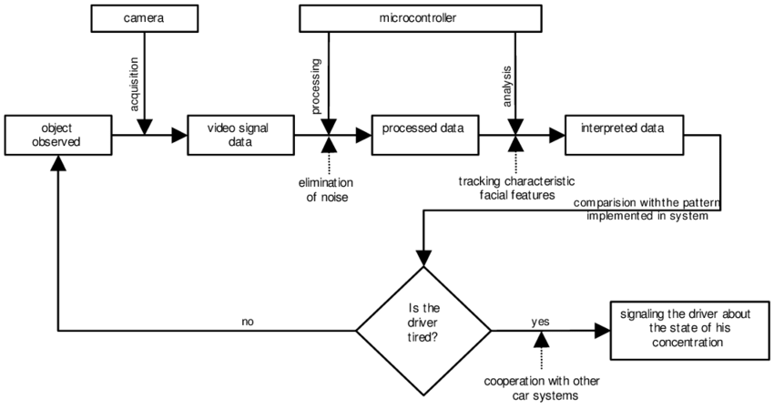
ARCHITECTURE DIAGRAM

Slide 14
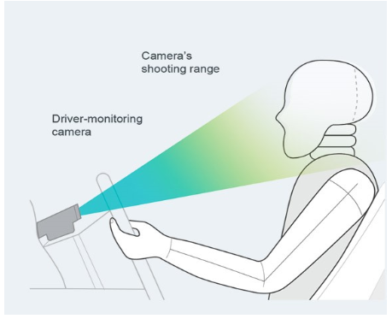
VISUAL REPRESENTATION

Slide 15
PROJECT MODULES
There are 3 modules:
Importing libraries
Image Capturing
Image Processing

Slide 16
ALGORITHM
Step 1 – Take image as input from a camera.
Step 2 – Detect the face in the image and create a Region of Interest (ROI).
Step 3 – Detect the eyes from ROI and feed it to the classifier.
Step 4 – Classifier will categorize whether eyes are open or closed.
Step 5 – Calculate score to check whether the person is drowsy.

Slide 17
PSEUDO CODE
drowsinessDetection →
eyeCheck →
set blinkTime to X
set amplitude to Y
set six eye point to ep[]
openCloseCheck = (|ep[2]- ep[6]|+|ep[3]-
ep[5]|)/(2*|ep[1] – ep[4]|)
if current blinkTime > X and current amplitude < Y
return True
else return False
yawningCheck →
set yawning threshold
set the RGB image to Binary
do find the biggest hole in the mouth
do verify the mouth opening
do if current yawning status > yawning threshold
return True
else return False

Slide 18
PSEUDO CODE
alarm →
if eyeCheck() == true OR yawningCheck() == true
ringAlarm()
eyelidClosedFrameCount →
if frameCount > 15
operateAutonomously()
else drowsinessDetection()
else drowsinessDetection()
operateAutonomously →
bookNSPS()
pathNavigation()
notifyAuthority()

Slide 19
UML DIAGRAMS

Slide 20
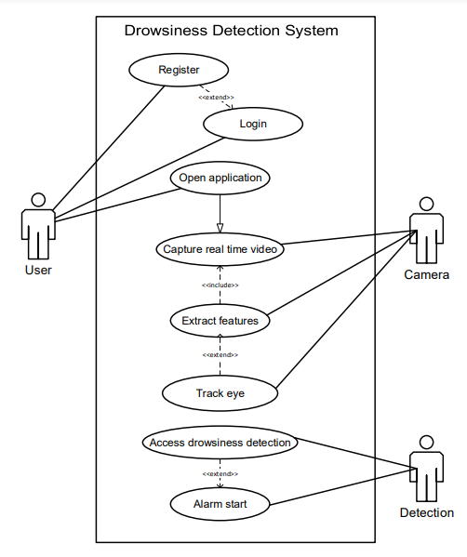
USE CASE DIAGRAM

Slide 21
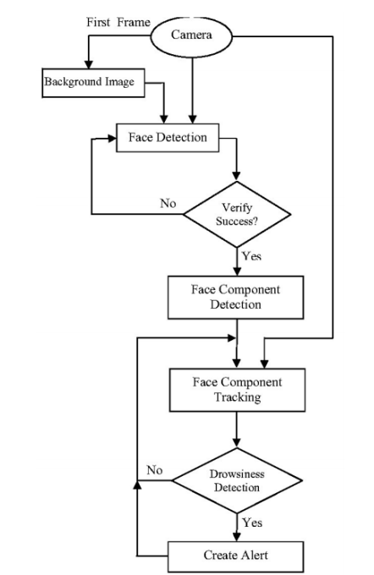
ACTIVITY DIAGRAM

Slide 22
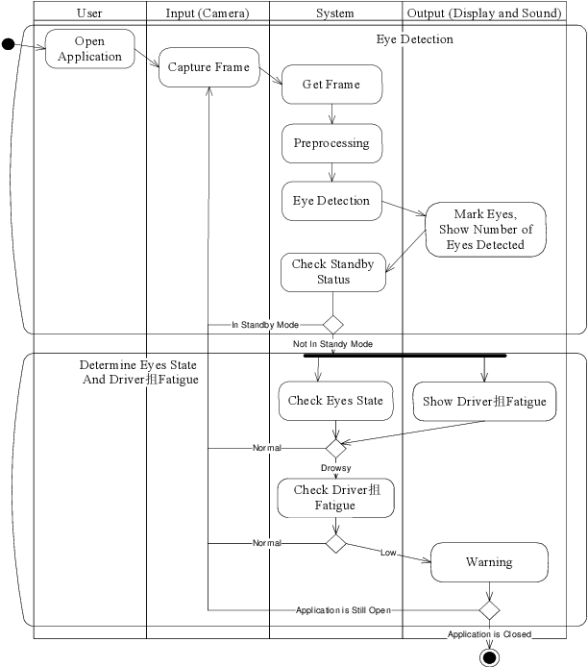
SEQUENCE DIAGRAM

Slide 23
SOFTWARE REQUIREMENT
PYTHON
TENSOR FLOW
OPEN CV
HARDWARE REQUIREMENT
RASPBERRY PI 3
CAMERA
GPS MODULE
GSM MODULE
VIBRATOR

Slide 24
CONCLUSION
By this system,
It prevents the accidents during driving.
A camera is used to monitor the driver’s eye movement.
If the predefined safety conditions are not met , it alerts the driver by producing some vibrations in the seat belt.
Taking an account of worst case scenario , if any accident occurs , the location of the vehicle is notified to the nearby hospitals.

Slide 25
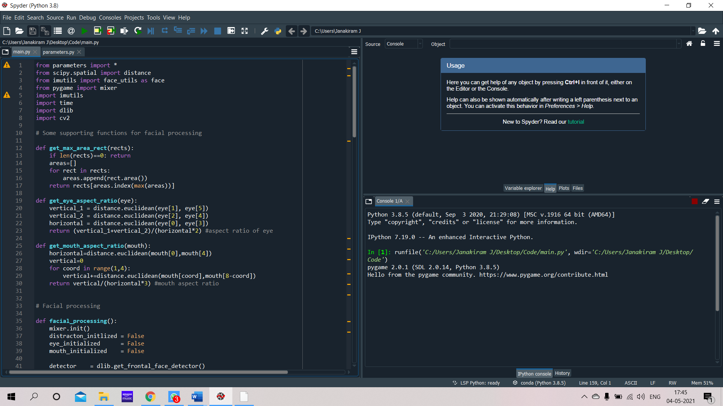
SNAP SHOTS

Slide 26
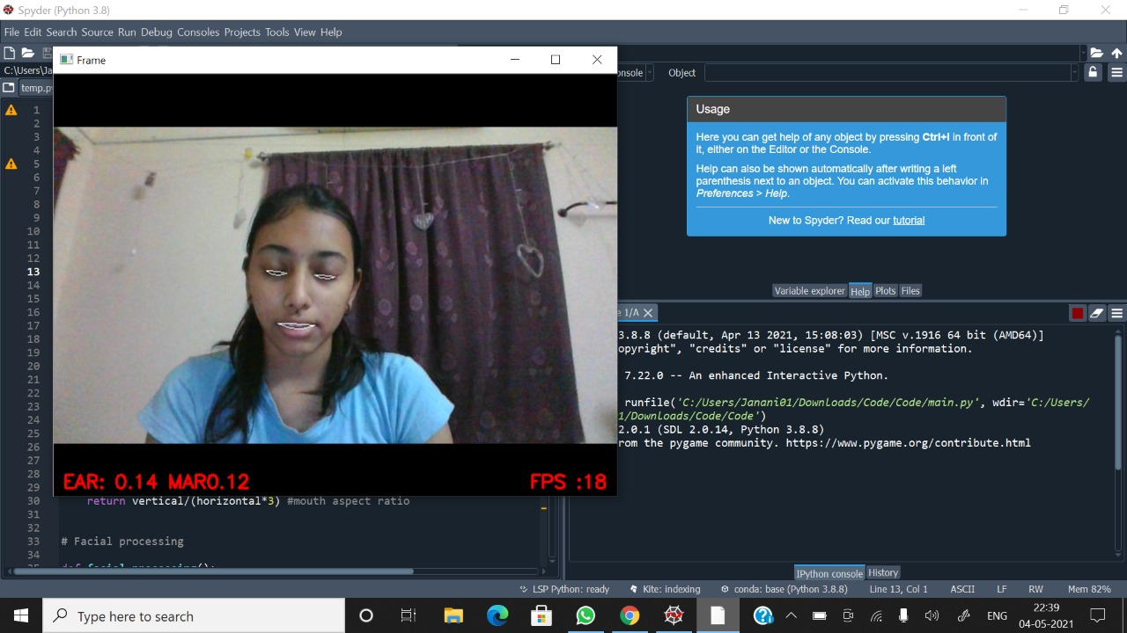
SNAP SHOTS

Slide 27
REFERENCES
Gerald Kaefer, Guenter prochart and Reinhold Weiss [1] proposed a wearable alertness monitoring the guard using the physical measures like detecting eye lid closure, reaction time, head movements. A high level of alertness is one of the most important requirements for people working in dangerous environments was then studies.
Prachi Parikh and Evangelia Micheli-Tzankao[2] introduced an ECG signal as an alertness of an individual. The movement of an individual was recorded and their movement was analyzed. It had a color code which makes it easier to observe the ways, which enables to give instant feedback.
IN [3] knowing that ECG and EOG signals are complex in nature , the process has to be investigated precisely in nature. Thus, EOG signals were recorded between Cornea and Retina. Discrete wavelet was used to decompose the EOG signals

Slide 28
REFERENCES
Smita Jawale, Pragati Malvadia, Ashwini Meena [4] has introduced a image monitoring technique ie, a camera is fixed so that it keeps monitoring the person’s movement. It senses if the person lose his consciousness and immediately sends an alert alarm. They also proposed a computing horizontal technique so as to know the intensity change of the eye location.
Raees Ahmad[5]improved the system by implementing it by using the cascade object identifier from vision toolbox of matlab, that detects face , eyes ,nose and mouth from the image which Is captured using the web camera and the system provides efficient analysis and good efficiency because,it formulates the different categories of drivers like the drivers with glasses under different light intensities and normal drivers too.
Takchito Hayami[6] introduced a system called PERCLOS which determines frequency between the wakeful and drowsy state of the driver. It is determines the threshold level between the possibilities and the distinction error was evaluated and the drowsy state was analyzed.

Slide 29
REFERENCES
Robert Gabriel Lupu [7] has stated that depending upon the source light point of view , there are two approaches namely based on ambient and infrared lights. This has an advantage of low computing resources , this comes under the feature based algorithm. On the other hand , the model based algorithm do not detect features but rather finds the best model that is consistent with the image.
Algorithm for Eye Detection on Grey Intensity Face[8] this paper presents a robust eye detection algorithm for grey intensity images.
Face Detection using Haar Casades [9] Object Detection using Haar feature-based cascade classifiers is an effective object detection method proposed by Paul Viola and Michael Jones in their paper “Rapid Object Detection using a Boosted Cascade of Simple Features” in 2001.
Apurva Patil , Archies Patil, Siddhi Shenoy [10] proposed a computer vision technology which involves in determining the observation of eye movements , mouth movement and blink pattern. This includes the yawning which helps in determining the accurate mouth movement.

Slide 30
Thank you.

